Slide 1
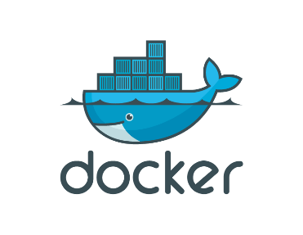
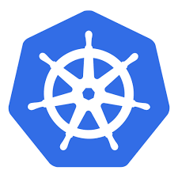
Introduction to K8s (Kubernetes)
Samuel Dratwa
Samuel.dratwa@gmail.com

Slide 2
Agenda
Day 1
Introduction
Recap/baseline of Docker containers
K8s components and architecture (HL)
Interacting with Kubernetes
Day 2
Pods, Deployments & Workloads
Networking in Kubernetes
Storage & Configuration
Scaling & Auto-scaling
Day 3
Hands-on AWS EKS
Day 4 (TBD)
Observability & Monitoring
Security & RBAC
Helm – Package Management

Slide 3
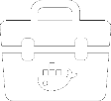


Docker Containers as a Service Platform
Build
Ship
Run
Docker Toolbox
Docker Trusted Registry
Docker Universal Control Plane
“docker push” with image signing
Search/browse repos
Teams-based RBAC
View signed images
Deleting tags
Authentication
Deploy and scale-out app
Monitor stats
Secrets management

Slide 4
Containers vs. VMs
Containers are isolated, but share OS and, were appropriate, bins/libraries
App
A
App
A’
App
B
Bins/
Libs
Bins/
Libs
Bins/
Libs
…result is significantly faster deployment, much less overhead, easier migration, faster restart
VM
Guest
OS
Guest
OS
Guest
OS
Guest
OS
Guest
OS
App A
App A’
App B
App B’
App B’
App B’
Container
Docker
Hypervisor (Type 2)
Bins/Libs
Bins/Libs
Host OS
Host OS
Server
Server

Slide 5
Why are Docker containers lightweight?
VMs
Containers
App
A
App
A
App
A’
App
A
App
A
App Δ
Bins/
Libs
Bins/
Libs
Bins/
Libs
Bins/
Libs
Bins/
Guest
OS
Guest
OS
Guest
OS
Guest
OS
Original App
(No OS to take up space, resources,
or require restart)
Copy of
App
No OS. Can
Share bins/libs
Modified App
Copy on write capabilities allow
us to only save the diffs
Between container A and container A’
Every app, every copy of an
app, and every slight modification
of the app requires a new virtual server

Slide 6
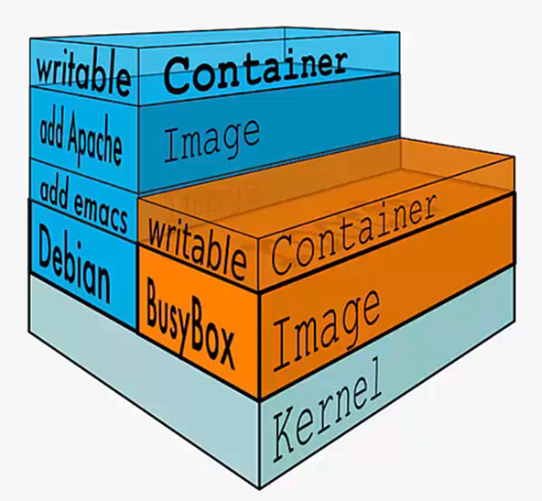
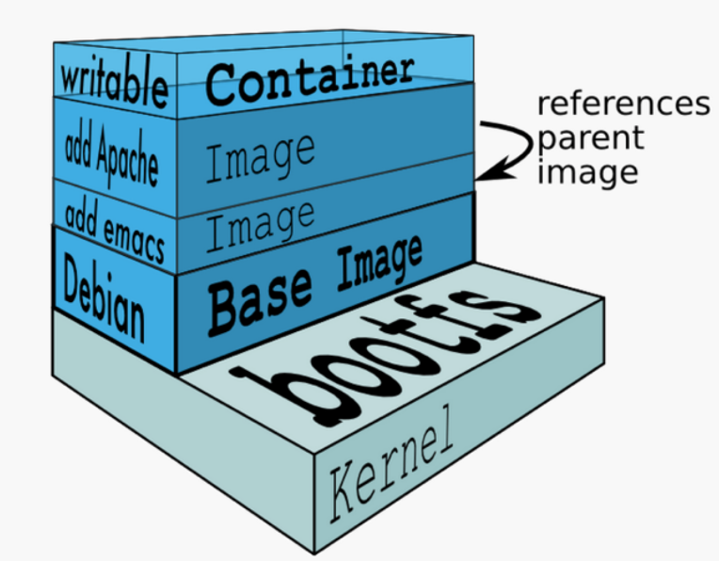
Image layers

Slide 7
What are the basics of the Docker system?
Container A
Docker
Container
Image Registry
Push
Search
Pull
Source Code Repository
Run
Build
Dockerfile
For
A
Container A
Container B
Container C
Docker
Docker Engine
Host 1 OS (Linux)
Host 2 OS (Linux)

Slide 8
Changes and Updates
Docker
Container
Image Registry
App
A
Push
App Δ
Bins/
Libs
Bins/
Base
Container
Image
Container Mod A’
Container Mod A’’
App Δ
Update
App
A
Bins/
App
A’’
Bins/
Libs
Bins/
Libs
Bins/
Docker Engine
Docker Engine
Host is now running A’’
Host running A wants to upgrade to A’’. Requests update. Gets only diffs

Slide 9
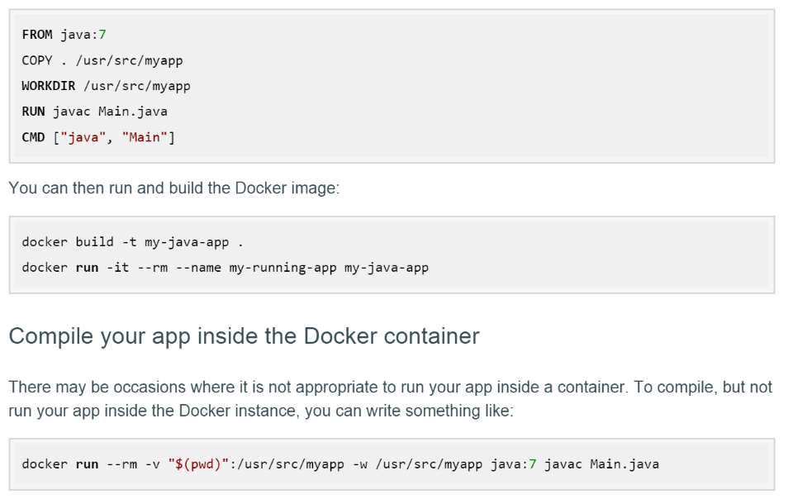
Docker for developers / Dockerfile

Slide 10
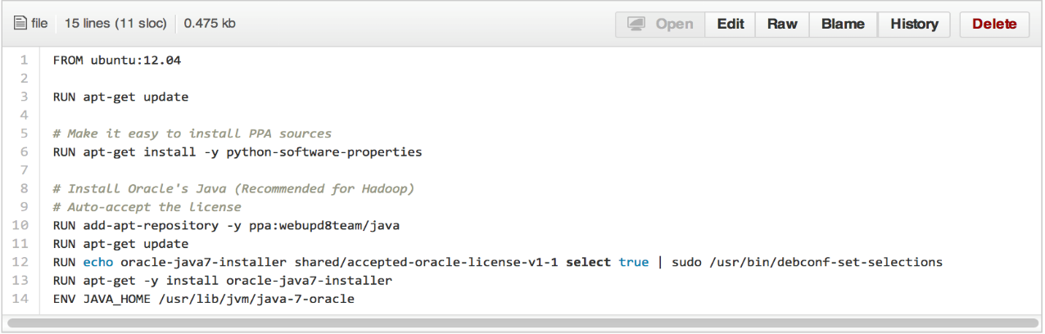
Dockerfile ……
• Like a Makefile (shell script with keywords)
• Extends from a Base Image
• Results in a new Docker Image
• Imperative, not Declarative
A Docker file lists the steps needed to build an images
• docker build is used to run a Docker file
• Can define default command for docker run, ports to expose, etc

Slide 11
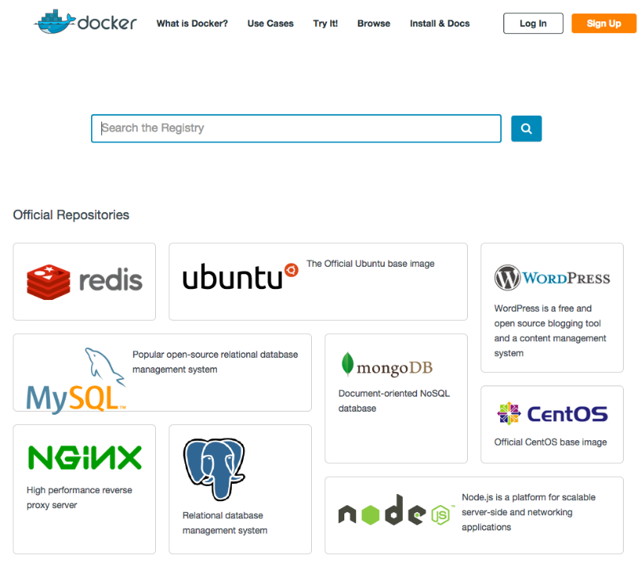
Docker Hub
Notes:
Docker Hub is Docker’s cloud service for …
Publishing and discovering container images through the public registry
Team collaboration and automation of application workflows

Slide 12



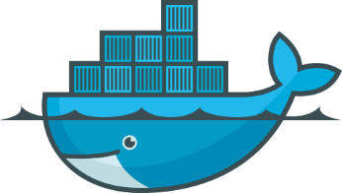

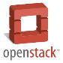


Build & Ship
Docker Hub
QA
Dev & QA Colleagues
Developers

Slide 13
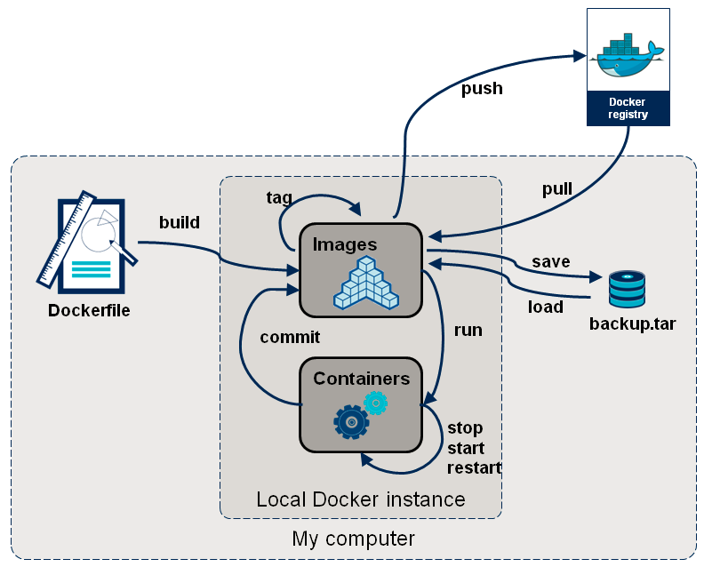
Docker Container Lifecycle
• The Life of a Container
– Conception
• BUILD an Image from a Dockerfile
– Birth
• RUN (create+start) a container
– Reproduction
• COMMIT (persist) a container to a new image
• RUN a new container from an image
– Sleep
• KILL/stop a running container
– Wake
• START a stopped container
– Death
• RM (delete) a stopped container
• Extinction
– RMI a container image (delete image)

Slide 14
What’s missing

Slide 15
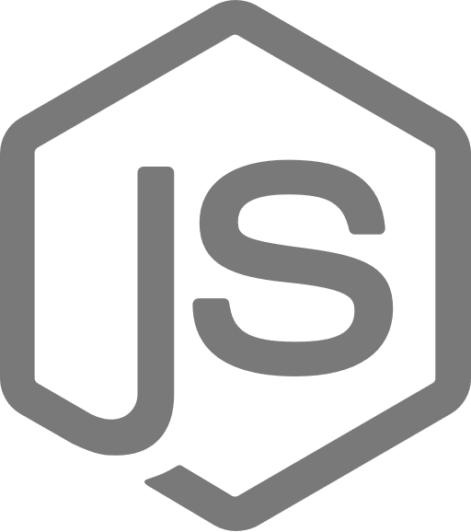
Orchestration
Health monitoring – Self healing
Scaling (Horizontal and Vertical)
Networking
Service discovery and load balancing
Automated rollout and rollback
Secrets and Configuration
Challenges building cloud applications
Optimizing for microservice development
</>
Focusing on business logic instead of microservice platform maintenance
.NET
Monitoring and governance at overarching and granular levels
Running highly secure applications at scale
Dealing with the complexity of network communications
Achieving reliable state and data consistency without latency issues
</>
Tracking multiple deployment pipelines while maintaining agile updates

Slide 16
Kubernetes
Pronounced /koo-ber-nay'-tace/
A Greek term for “ship master”.
Developed at/by Google.
The third iteration of container management.
Daddy was Omega.
Grandaddy was Borg.
Kubernetes is not a PaaS, just orchestration (Docker is the PaaS)
Kubernetes built to “planet scale”.
Google wants us to stop writing Kubernetes and use k8s instead
100% Open source, written in Go

Slide 17
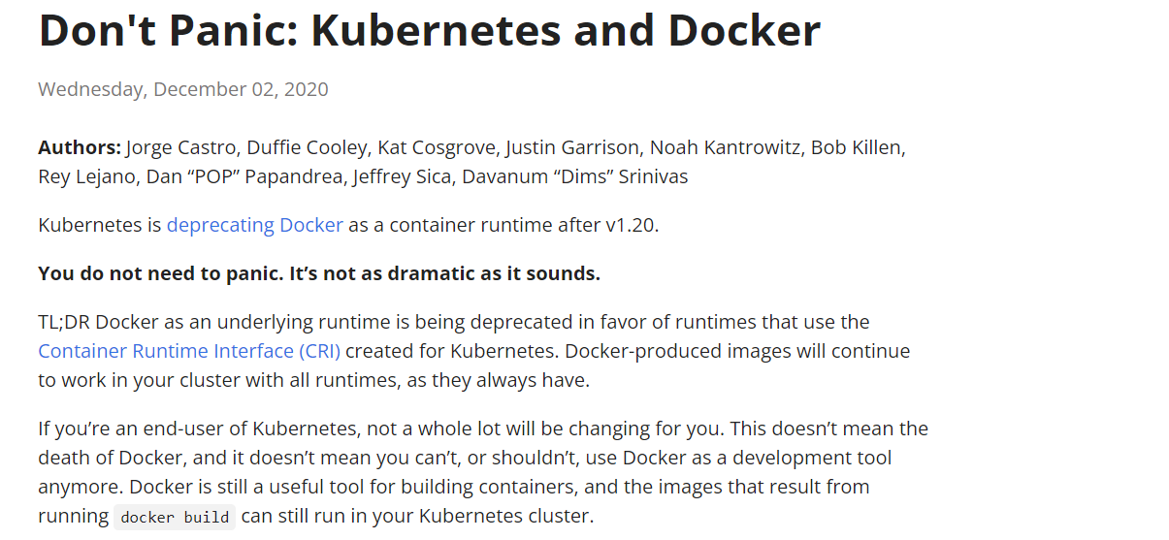
Notes:
https://kubernetes.io/blog/2020/12/02/dont-panic-kubernetes-and-docker/

Slide 18
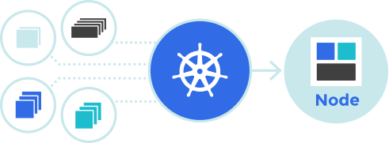
Kubernetes is an open-source system for automating deployment, scaling, and management of containerized applications.
Planet Scale
Designed on the same principles that allows Google to run billions of containers a week, Kubernetes can scale without increasing your ops team.
Never Outgrow
Whether testing locally or running a global enterprise, Kubernetes flexibility grows with you to deliver your applications consistently and easily no matter how complex your need is
Run Anywhere
on-premise, hybrid, or public cloud infrastructure, letting you effortlessly move workloads to where it matters to you.
Notes:
https://kubernetes.io/

Slide 19
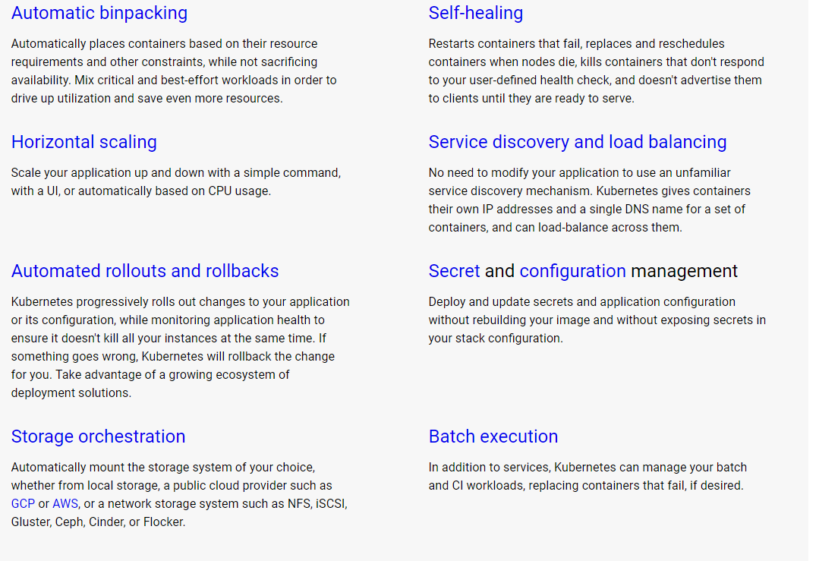
Kubernetes Features

Slide 20
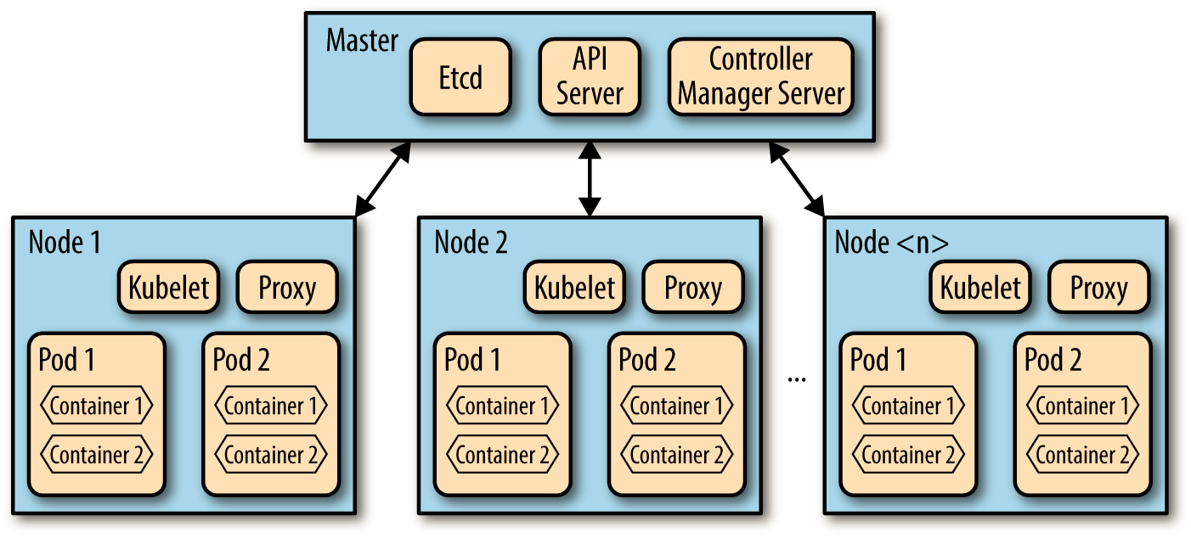
Kubernetes Layout

Slide 21
Master
API Server—Almost all components on both the master and nodes perform their functions by issuing API requests, which are processed by the API Server operating on the master node.
Etcd—Etcd is a service responsible for maintaining and replicating the cluster's current configuration and operational state. It functions as a lightweight distributed key-value store and was originally developed as part of the CoreOS project.
Scheduler and Controller Manager—These components are responsible for assigning containers (specifically pods) to appropriate nodes. They also ensure that the desired number of pods remains running consistently.

Slide 22
Node
Kubelet - A dedicated background service running on each node, responsible for executing commands from the master to create, delete, and monitor containers on that specific host.
Proxy - A basic network proxy that decouples the IP address of a target container from the service name it offers.
cAdvisor (optional) - Container Advisor is a specialized daemon that gathers, aggregates, analyzes, and exports data about active containers, including resource isolation details, historical usage, and essential network metrics.

Slide 23
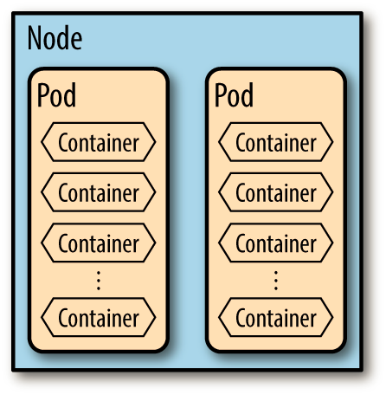
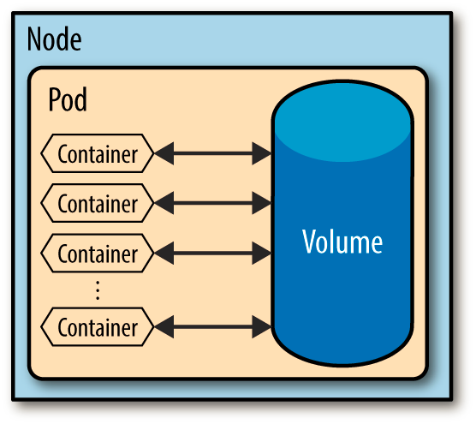
Pods
A pod is a collection of containers and volumes that are bundled and scheduled together because they share a common resource, usually a filesystem or IP address.

Slide 24
Why not just run multiple programs in a single (Docker) container?
Transparency. Making the containers within the pod visible to the infrastructure enables the infrastructure to provide services to those containers, such as process management and resource monitoring. This facilitates several conveniences for users.
Decoupling software dependencies. The individual containers may be versioned, rebuilt and redeployed independently. Kubernetes may even support live updates of individual containers someday.
Ease of use. Users don’t need to run their own process managers, worry about signal and exit-code propagation, etc.
Efficiency. Because the infrastructure takes on more responsibility, containers can be lighter weight.

Slide 25
Containers per pod best practice
Best practice is to run one container in a pod (and one microservice in a container), with additional maximum one sidecar container. But there are several pattern where several containers can be in the same pod:
Sidecar Pattern - the most popular use cases for multi-container pods. One container in the pod is the "main" application container, and one or more additional containers (sidecars) augment its functionality (monitor, login, etc.)
Ambassador Pattern - a container acts as a proxy to facilitate communication between the pod's main container and external services (i.e. Envoy/ISTIO)
Adapter Pattern - is used when you need a container to modify the data before it is passed to or after it is received by the main application (text to JSON)
Init Containers - special containers that run before the main application container(s) in a pod start

Slide 26
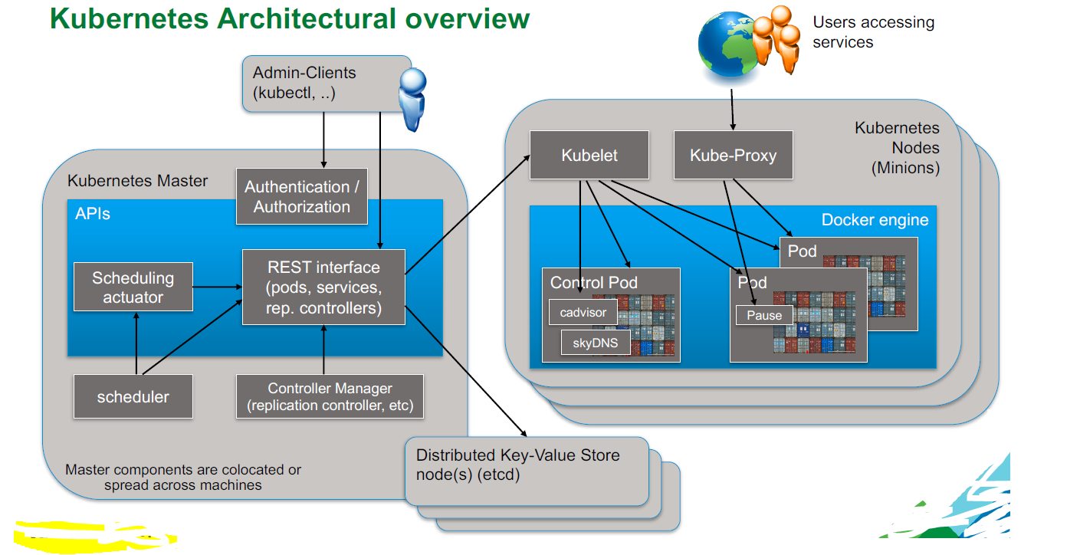

Slide 27
Descriptors
apiVersion: v1
kind: Pod
metadata:
name: ""
labels:
name: ""
namespace: ""
annotations: []
generateName: ""
spec:
? "// See 'The spec schema' for
details."
: ~
{
"kind": "Pod",
"apiVersion": "v1",
"metadata": {
"name": "",
"labels": {
"name": ""
},
"generateName": "",
"namespace": "",
"annotations": []
},
"spec": {
// See 'The spec schema' for details.
}
}
YAML is the clear winner. Especially in the context of Shannon’s Information Theory. The same density of information can be transmitted in less lines with YAML.

Slide 28
Pod Spec
spec:
containers:
-
args:
- ""
command:
- ""
env:
-
name: ""
value: ""
image: ""
imagePullPolicy: ""
name: ""
ports:
-
containerPort: 0
name: ""
protocol: ""
resources:
cpu: ""
memory: ""
restartPolicy: ""
volumes:
-
emptyDir:
medium: ""
name: ""
secret:
secretName: ""
Notes:
https://github.com/kubernetes/kubernetes.github.io/blob/master/docs/user-guide/pods/pod-spec-common.yaml

Slide 29
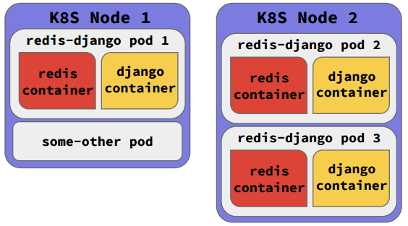
Pod spec example
apiVersion: v1
kind: Pod
metadata:
name: redis-django
labels:
app: web
spec:
containers:
- name: key-value-store
image: redis
ports:
- containerPort: 6379
- name: frontend
image: django
ports:
- containerPort: 8000

Slide 30
The Pod Lifecycle in a Cluster
Let’s say you want to fire up a pod. With kubectl you would:
Make a Pod request to the API server using a local pod definition file.
The API server saves the info for the pod in ETCD.
The scheduler finds the unscheduled pod and schedules it to a node.
Kubelet sees the pod scheduled and fires up Docker.
Docker runs the container.
The entire lifecycle state of the pod is stored in ETCD.
Most of the things in Kubernetes are built on top of Pods

Slide 31
kubectl create - Create a resource from a file
// Create a service using the definition in example-service.yaml.
$ kubectl create -f example-service.yaml
// Create a replication controller using the definition in example-controller.yaml.
$ kubectl create -f example-controller.yaml
// Create the objects that are defined in any .yaml, .yml, or .json file within the <directory> directory.
$ kubectl create -f <directory>

Slide 32
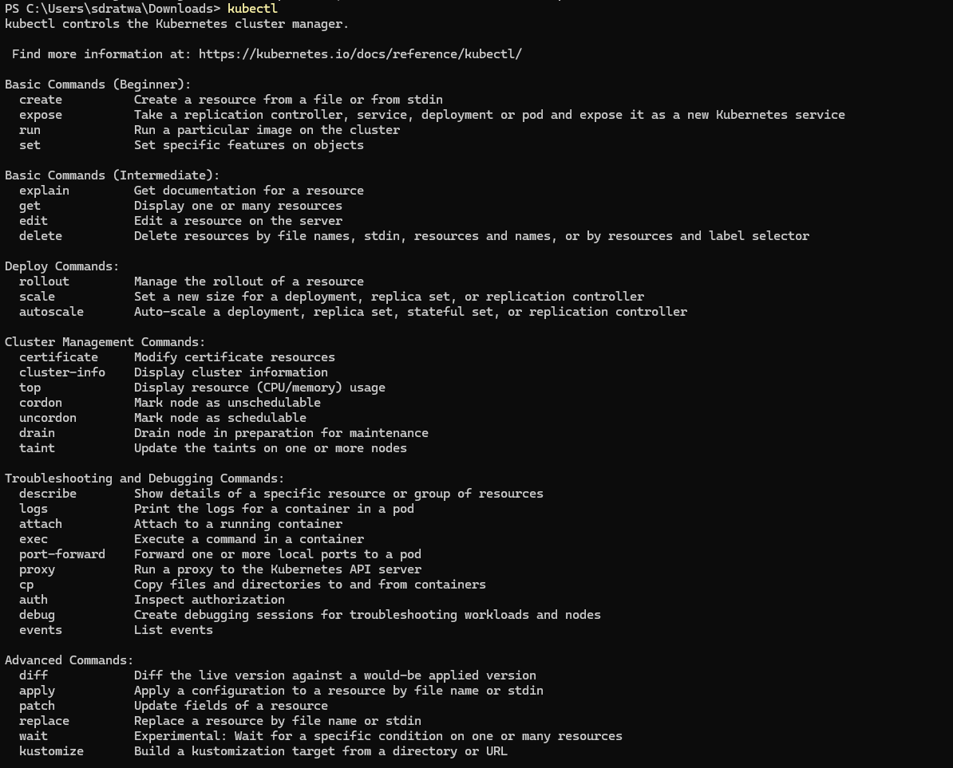
Kubectl commands

Slide 33
Using kubectl: Commands and Configuration
`kubectl` is the command-line tool used to interact with Kubernetes clusters. It communicates with the API server to deploy, inspect, and manage resources.
Key Concepts
Context: Defines which cluster, user, and namespace `kubectl` communicates with.
Configuration file: Stored at `~/.kube/config`.
Authentication: Managed via tokens, certificates, or cloud provider credentials.
Common Commands
`kubectl cluster-info` → Displays master and service endpoints
`kubectl get pods` / `kubectl get svc` → Shows running pods or services
`kubectl apply -f deployment.yaml` → Deploys resources defined in YAML
`kubectl describe pod <name>` → Shows detailed info about a resource
`kubectl logs <pod>` → Displays container logs
`kubectl exec -it <pod> -- /bin/bash` → Opens shell in a running container

Slide 34
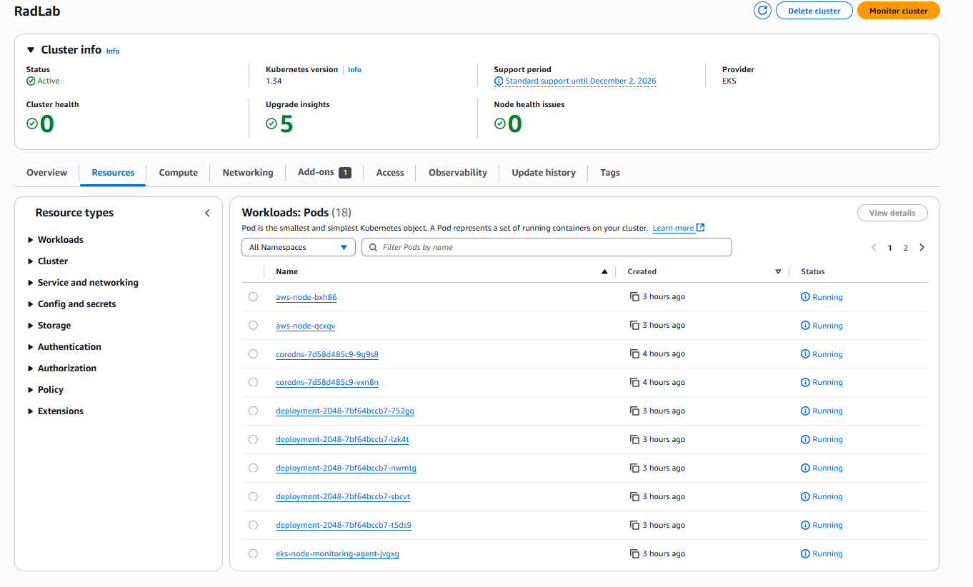

Slide 35
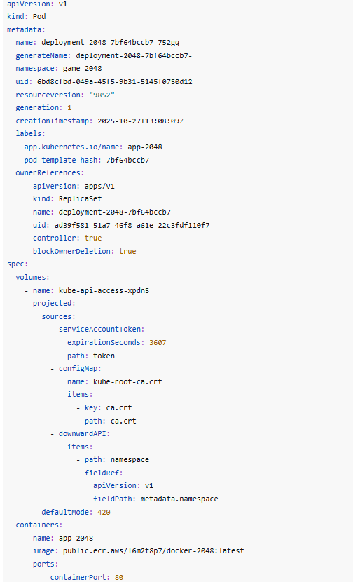
🔍 JSONPath and Resource Querying
JSONPath is a query language used to extract specific fields from Kubernetes resources. It helps you filter, select, and display precise information from JSON outputs of `kubectl` commands.
Examples:
`kubectl get pods -o jsonpath='{.items[*].metadata.name}'` → List pod names
`kubectl get nodes -o jsonpath='{.items[*].status.addresses[?(@.type=="InternalIP")].address}'` → Show node IPs
`kubectl get svc myservice -o jsonpath='{.spec.ports[0].port}'` → Extract service port
`kubectl get pods -o=jsonpath='{range .items[*]}{.metadata.name}:{.status.phase}{"\n"}{end}'` → Pod name & status list
Tips for Effective Querying
Combine with `grep` or `awk` for advanced filtering.
Use `-o json` with `jq` for complex JSON analysis.
JSONPath supports wildcards (`*`) and filters (`?()`) for precision.
Use `--show-labels` or label selectors (`-l key=value`) with `kubectl get`.

Slide 36
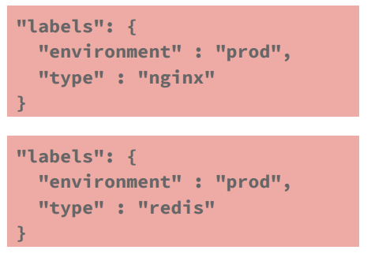
Labels
A label is a key-value pair that is assigned to objects in k8s.
Pods, services, etc
Labels can be used to organize and to select subsets of objects
Labels can be attached to objects at creation time and subsequently added and modified at any time

Slide 37
Label Selectors
Two kinds of label selectors
equality-based (IS/IS NOT)
tier = frontend
tier != frontend
tier != frontend, game = super-shooter-2
set-based (IN/NOT IN)
environment in (production, qa)
tier notin (frontend, backend)

Slide 38
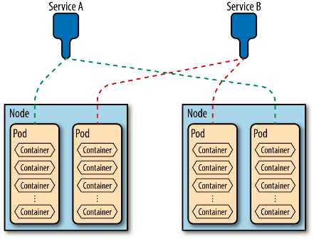
Services
A Kubernetes Service is an abstraction which defines a logical set of Pods and a policy by which to access them
The set of pods gathered by a Service is determined by a label selector
A service is a long-lived, well-known endpoint that points to a set of pods in a cluster. It consists of three things:
external IP address (known as a portal, or sometimes a portal IP)
port
label selector.

Slide 39
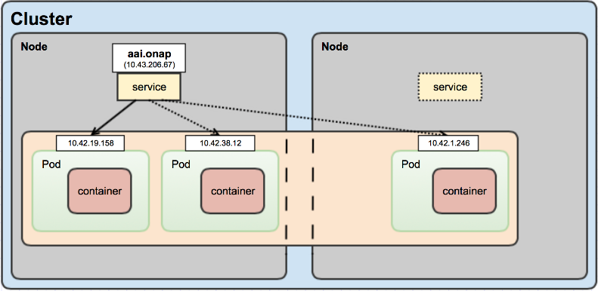
Service Discovery
Kubernetes micro-service
Service defines a logical set of Pods
Manages state across the set
Provides access to healthy Pods
Service hostname mapped to durable virtual IP (aka cluster IP)
Pod IPs not durable
changes over time (restarts)
Methods of discovery
Kubernetes DNS (preferred)
Container injected env vars

Slide 40
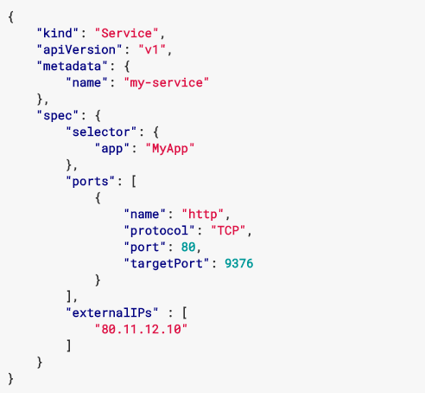
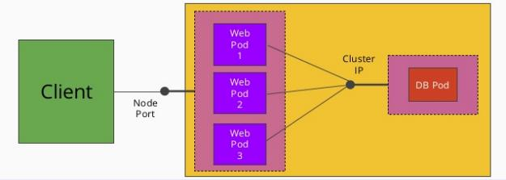
Service Example

Slide 41
Service Types
Kubernetes ServiceTypes allow you to specify what kind of Service you want:
ClusterIP: Exposes the Service on a cluster-internal IP. Choosing this value makes the Service only reachable from within the cluster. This is the default ServiceType.
NodePort: Exposes the Service on each Node's IP at a static port (the NodePort). A ClusterIP Service, to which the NodePort Service routes, is automatically created. You'll be able to contact the NodePort Service, from outside the cluster, by requesting <NodeIP>:<NodePort>.
LoadBalancer: Exposes the Service externally using a cloud provider's load balancer. NodePort and ClusterIP Services, to which the external load balancer routes, are automatically created.
Ingress is not a Service type, but it acts as the entry point for your cluster. It lets you consolidate your routing rules into a single resource as it can expose multiple services under the same IP address

Slide 42
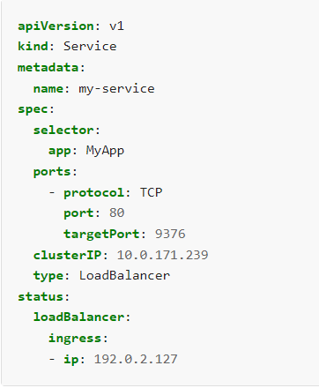
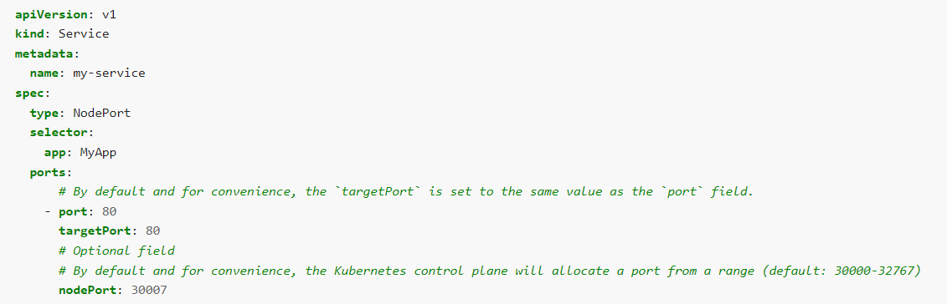
Node port & load balancer
K8s load balances across all healthy pods within a service
rr: round-robin
lc: least connection
dh: destination hashing
sh: source hashing
sed: shortest expected delay
nq: never queue

Slide 43
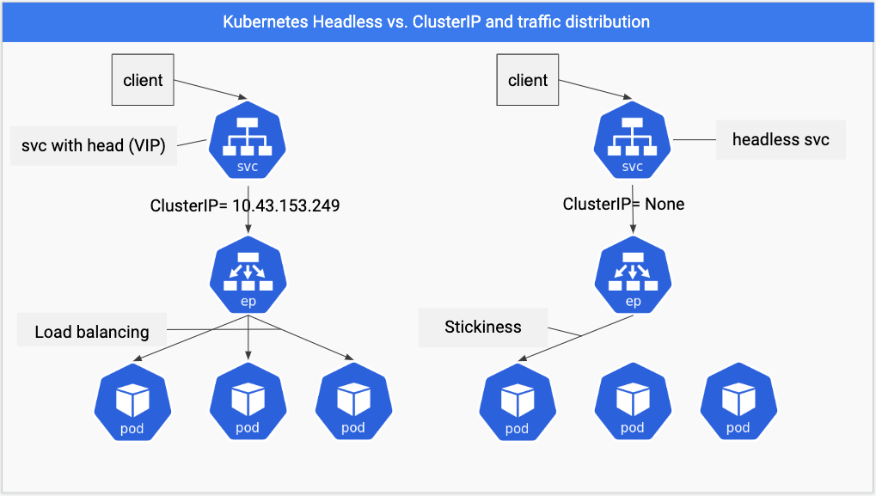
Notes:
https://github.com/arashkaffamanesh/practical-kubernetes-problems#headless-services-for-stickiness

Slide 44
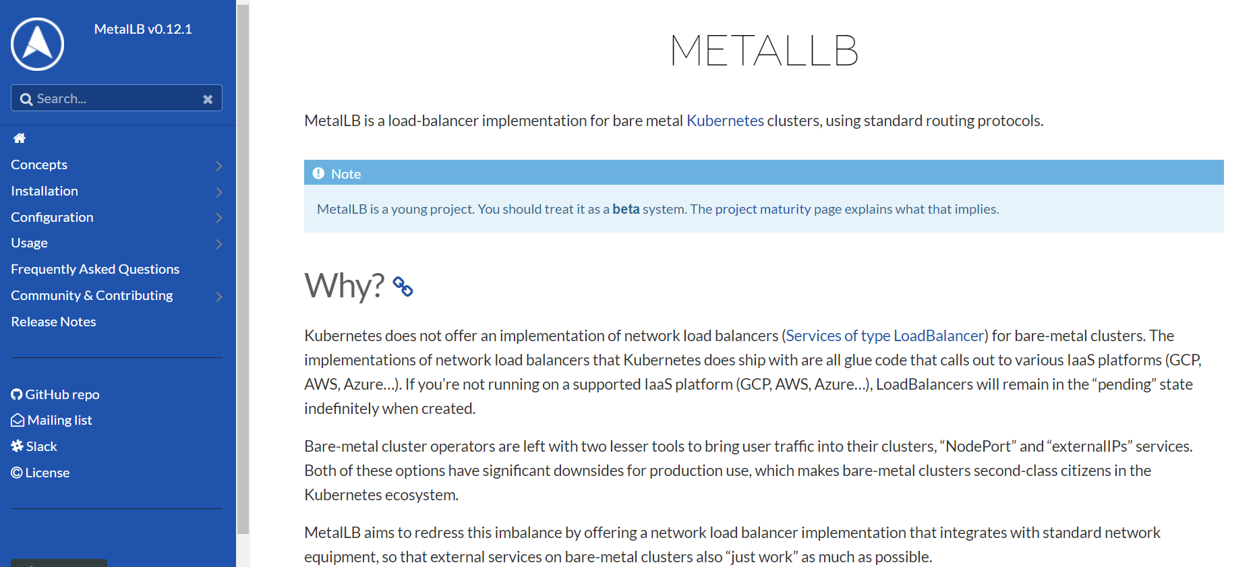
MetalLB

Slide 45
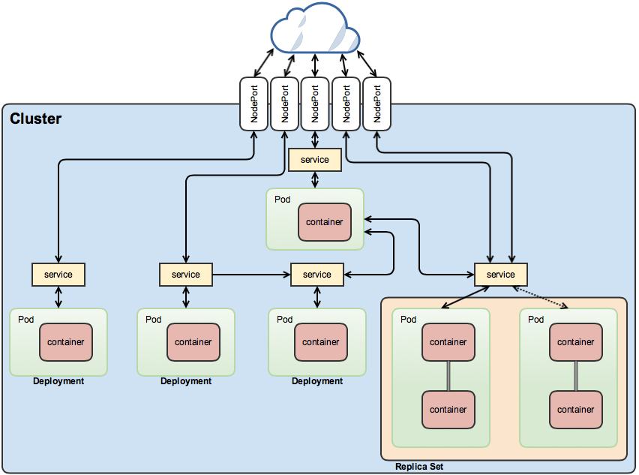

Slide 46
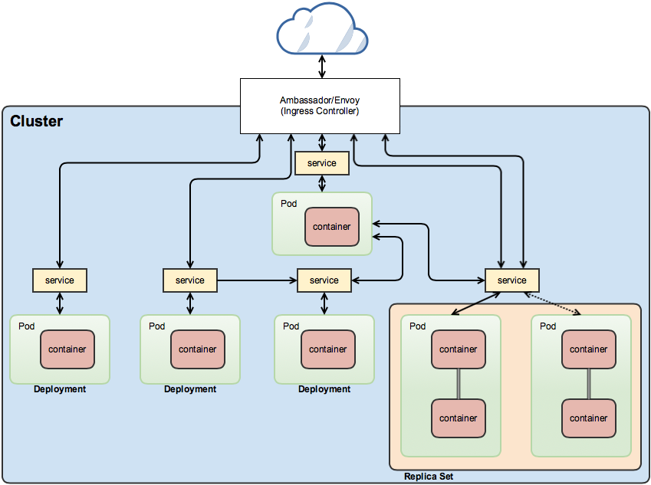

Slide 47
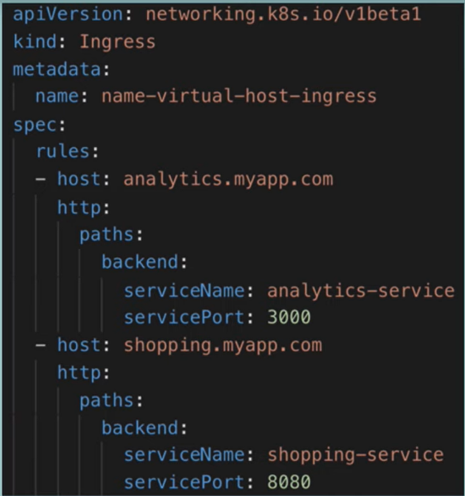
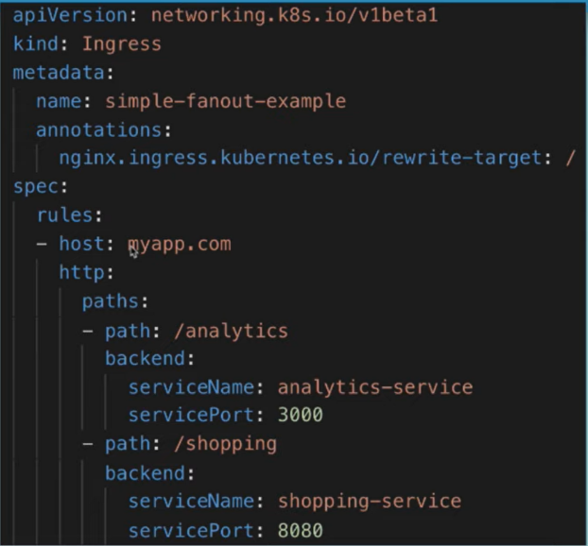
Ingress

Slide 48
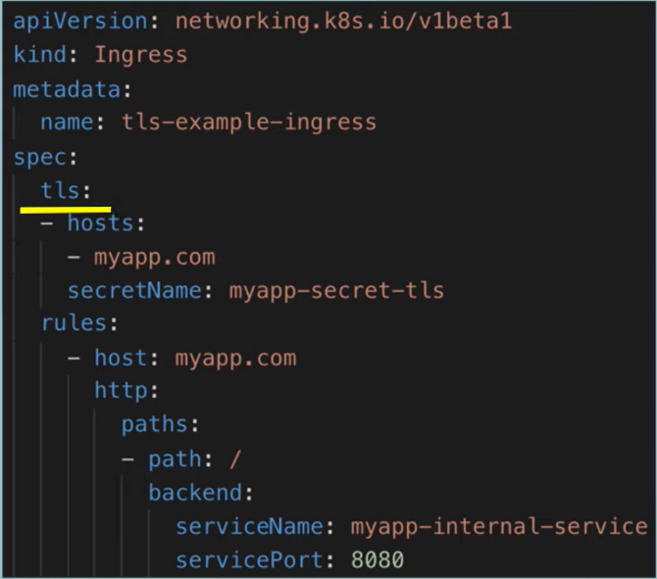
TLS ingress

Slide 49
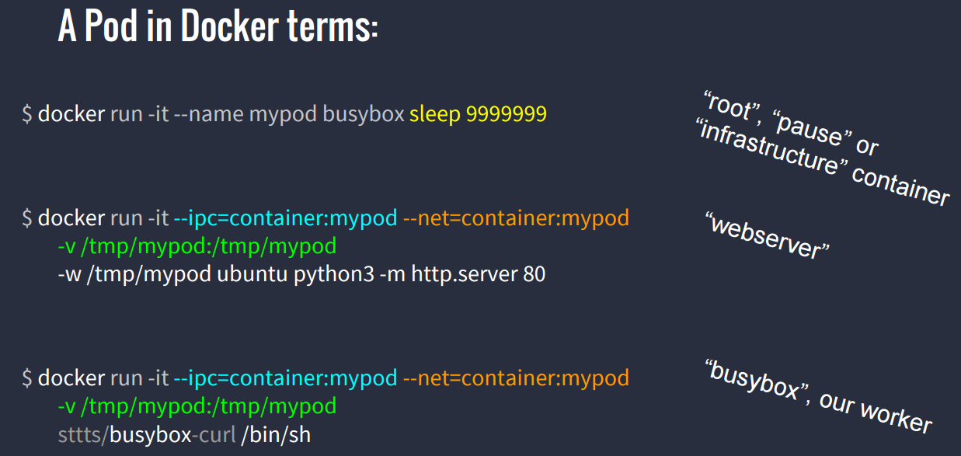

Slide 50
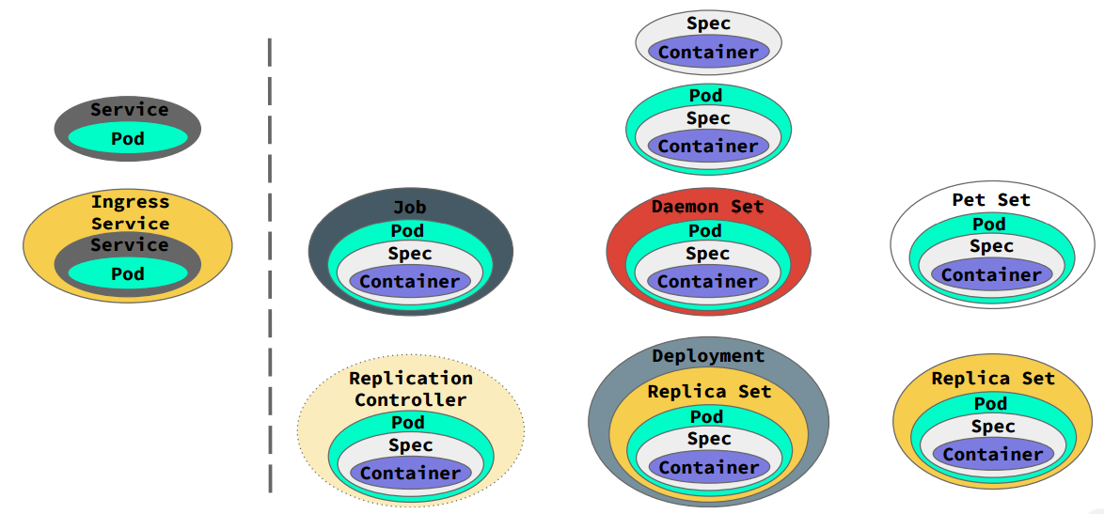
Pod types / kind

Slide 51
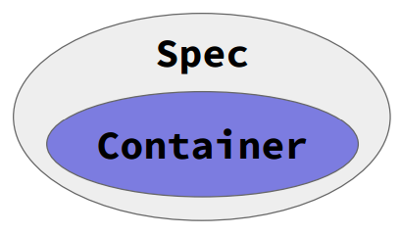
The base – container & spec
The only required field in spec is containers. it requires (mandatory only) two entries
name
image
Part of the spec is for all containers in a pod:
restartPolicy
Volumes
The spec is very extensible by design
Specs don’t do anything by themselves; for that you need a pod .

Slide 52
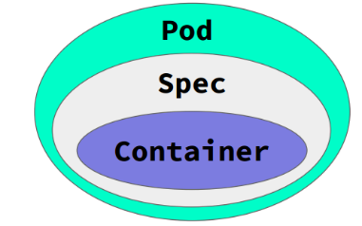
Pods
Pods are just collections of containers that share a few things:
Access to volumes
Networking
Are co-located
Restart together
Usually scale together
Etc.
Pods can be run by themselves but have no guarantee to restart or stay running or scale or do anything useful

Slide 53
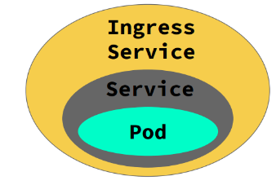
Ingress Service
Services point to a Pod or to an external source.
With Pods a virtual endpoint is created then routed to using the kube-proxy
For non-pod services a virtual IP in the cluster is used to route externally .
Ingress Service = AWS API Gateway
An Ingress Controller sits at the boundary of the cluster and routes requests to Services
One Ingress Controller can handle multiple domains
Each route can point to a different Service
Relies on the creation of an Ingress Controller in the cluster (another service that is not enabled by default).

Slide 54
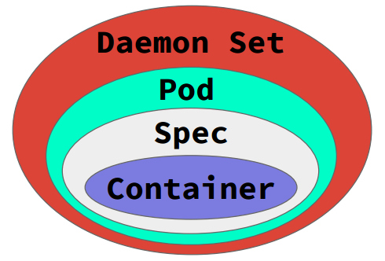
Daemon sets
Daemons is an object that ensures that a copy of each Pod runs on each node. This is commonly used to make sure side-car containers are running across the cluster.
If new nodes come up they’ll get a copy of the daemon set and will come up.
Daemon sets don’t have scaling rules.

Slide 55
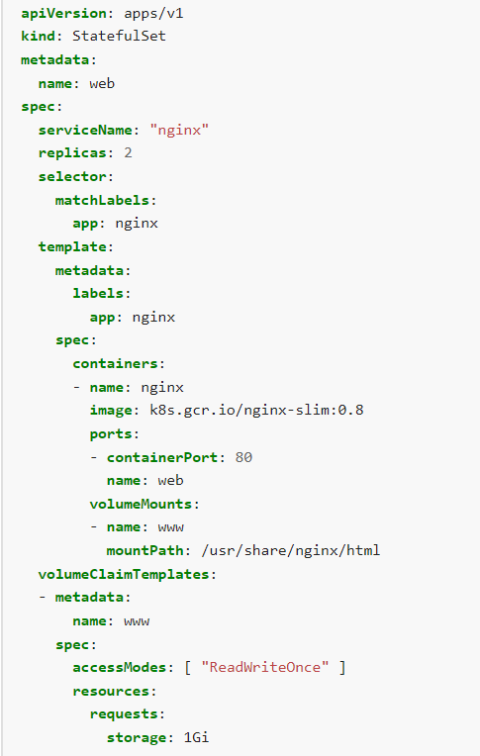
StatefulSet pods
StatefulSet allow you to create complex microservices across the cluster.
They have the ability to set dependency on other containers.
They require:
A stable hostname, available in DNS
An ordinal index
Stable storage: linked to the ordinal & hostname
It is used for stateful pods

Slide 56
Replcia Set
A Replication Controller (deprecated) was the best way to run Pods.
You set a number of pods to run and the Replication Controller made sure that the number was running across the cluster.
Rolling updates could be performed by starting a new Replication Controller and scaling up.
A Replica Set differs from the Replication Controller because it can be updated.
If you update the Replica Set template you can fire and update and automatically roll changes
Rollbacks are also built in.
Replica Set are not designed to be used directly. For that you need Deployments.

Slide 57
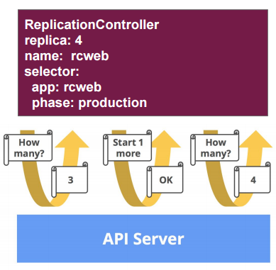
replication controller \ ReplicaSet
apiVersion: v1
kind: ReplicationController
metadata:
name: rcweb
labels:
name: rcweb
spec:
replicas: 4
selector:
app: rcweb
phase: production
template:
metadata:
labels:
app: rcweb
role: frontend
phase: production
name: rcwebpod
spec:
containers:
- name: staticweb
image: sliranc/rcweb:latest
Pod
Temp

Slide 58
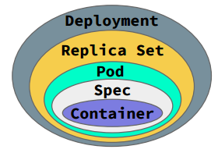
Deployments, The king of the hill
A Deployment controls the running state of Pods and Replica Sets.
In k8s it is the primary object you should be manipulating.
Deployments have:
History
Rolling updates
Pausing updates
Roll-backs

Slide 59
A Virtual Cluster in Your Cluster
A namespace as an isolated section of a cluster.
It’s a virtual cluster in your cluster.
Each cluster can have multiple namespaces.
The root services have their own.
Namespaces are in network isolation from each other and can (are normally) used to house different environments on the same cluster.
resources (pods, services, replication controllers, etc.)
policies (who can or cannot perform actions in their community)
constraints (quota, etc.)
Kubernetes starts with two initial namespaces:
default - The default namespace for objects with no other namespace.
kube-system - The namespace for objects created by the Kubernetes system

Slide 60
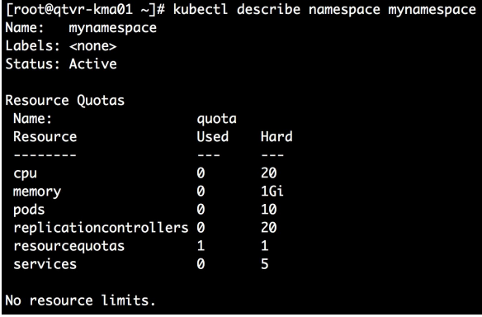
ResourceQuota (for namespace)
apiVersion: v1
kind: ResourceQuota
metadata:
name: quota
spec:
hard:
cpu: "20"
memory: 1Gi
pods: "10"
replicationcontrollers: "20"
resourcequotas: "1"
services: "5"

Slide 61
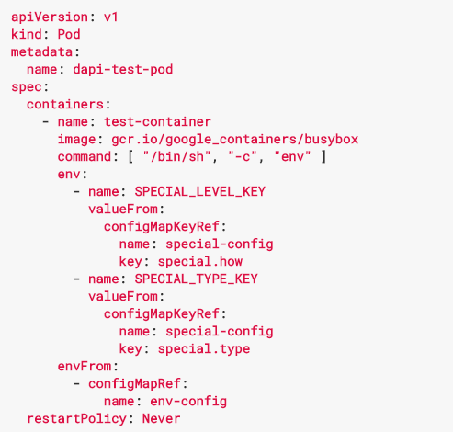
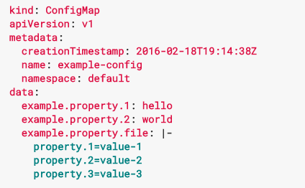
ConfigMap
ConfigMap is a resource available in Kubernetes for managing application configuration.
The goal is to decouple the app configuration from the image content in order to keep the container portable and k8s agnostic.
ConfigMap are key \ value pairs of configuration data.

Slide 62
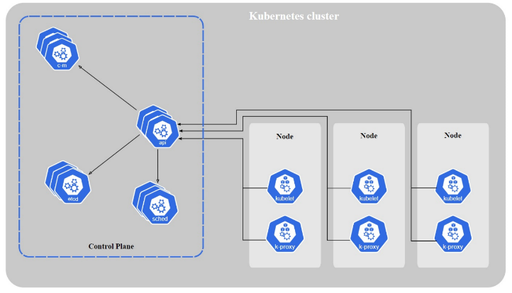
K8s built-in components
Master
API-server
etcd
Controllers
Deployment
StatefulSet
Services
ClusterIP
NodePort
Scheduler
Worker-nodes
Kubelet
Kube-proxy

Slide 63
K8s external components
Storage
Networking
CNI
Ingress
Services
LoadBalancer
Monitoring
Prometheus
Logging
ELK/EFK
These components may differ
between different customers !!!

Slide 64

Kubernetes Pain Point
1 MicroService == 1 POD + 1 Deployment + 1 ReplicationSet + 1 Service (+ 1 Ingress)
Lifecycle Management of Applications is challenging

Slide 65

What is Helm
Package manager for K8s
like yum, apt, pip but for Kubernetes Application
Search and reuse or start from scratch
Lifecycle Management
Create
Install
Upgrade/Rollback
Delete
Status
Versioning

Slide 66

Benefits

Slide 67

Helm Architecture
Helm Client
Command-line client
Interacts with Tiller Server
Deploy Applications from Local/Public Repository
Tiller Server
In-cluster (Pod)
Listens to the Helm client
Interacts with Kubernetes API Server
Manages the lifecycle

Slide 68
Helm Installation
Install Helm
Configure Helm
Check
curl -L https://git.io/get_helm.sh | bash
helm init
helm version
helm Client: &version.Version{SemVer:"v2.14.1", GitCommit:"5270352a09c7e8b6e8c9593002a73535276507c0", GitTreeState:"clean"}
Server: &version.Version{SemVer:"v2.14.1", GitCommit:"5270352a09c7e8b6e8c9593002a73535276507c0", GitTreeState:"clean"}

Slide 69
Helm Charts
Chart.yaml:
Spec (name, version description) of the Chart
templates:
Collection of K8S resource definition files
requirements.yaml
Include all the dependencies for this chart
values.yaml:
Yaml File for variables used in the k8s files
charts:
(optional) Sub-Charts with same directory structure

Slide 70
Helm Commands
Install or upgrade a chart
Find out information about running charts
Search charts in a repository
Create a new chart
Render chart templates locallyInstall Helm
helm install/upgrade
helm get/status/list
helm search
helm create
helm template

Slide 71







Technology Hierarchy

Slide 72

Notes:
https://blog.flant.com/small-local-kubernetes-comparison/
https://computingforgeeks.com/k0s-vs-k3s-vs-microk8s-kubernetes-distributions-comparison/

Slide 73

Prometheus structure

Slide 74
Metrics format
“Help” string - describes the metric
“Type” string - has 4 possible values:
Counter - counts occurrences (value can only increase)
Gauge - informs current value (value can be increased/decreased)
Histogram - Measures the frequency of values occurrences within a range by range-buckets
Summary - Captures individual observations from an event and summarizes them into several related metrics:
Sum of all values (aka observations)
Observation count
List of quantiles to compute (e.g. 0.1, 0.5 (median), 0.75, 0.95)
# HELP http_requests_total The total number of HTTP requests.
# TYPE http_requests_total counter
# This is a comment
http_requests_total{method="post",code="200"} 1027 1395066363000
http_requests_total{method="post",code="400"} 3 1395066363000
Notes:
https://prometheus.io/docs/introduction/overview/

Slide 75


Slide 76

Istio is an open source service mesh that layers transparently onto existing distributed applications. Istio’s powerful features provide a uniform and more efficient way to secure, connect, and monitor services. Istio is the path to load balancing, service-to-service authentication, and monitoring – with few or no service code changes. Its powerful control plane brings vital features, including:
Secure service-to-service communication in a cluster with TLS encryption, strong identity-based authentication and authorization
Automatic load balancing for HTTP, gRPC, WebSocket, and TCP traffic
Fine-grained control of traffic behavior with rich routing rules, retries, failovers, and fault injection
A pluggable policy layer and configuration API supporting access controls, rate limits and quotas
Automatic metrics, logs, and traces for all traffic within a cluster, including cluster ingress and egress

Slide 77
Envoy
Istio is able to apply security policies because it communicates through a proxy sidecar - Envoy
In Kubernetes the Envoy proxy is injected into your deployment spec and runs as another container
As soon as your deployment is scheduled, an iptables rule is created on the host and forever-more all traffic destined for your service is redirected to the Envoy proxy
An istio client library can be used to munge an existing k8s deployment spec before creation or you can deploy the Istio Sidecar-Injector as a Kubernetes mutating webhoook
The mutating webhook is configured to watch a given namespace and automatically inject the Envoy proxy at deployment time

Slide 78
Istio Control Plane
Service 1
Service 2
Envoy
Envoy
Istio Control Plane
Pilot
Mixer
Istio Certificate Authority

Slide 79
Istio Pilot
Pilot asynchronously configures the Envoy sidecar proxy that is embedded within every Kubernetes pod
Pilot populates the Envoy sidecar proxy with service-discovery endpoints and Envoy’s own configuration
Services always talk to each other by first going through the Envoy Proxy
Pod
Pod
Service 1
Service 2
Envoy
Envoy
Pilot

Slide 80
Istio Mixer
Mixer handles policy enforcement
Most often every request that will go to another service, will first go through Mixer for precondition checks like quota
After the request, Mixer is then called again to report telemetry data
Calls to Mixer are typically buffered for telemetry data such that Mixer only needs to be updated every 1k or so requests
Pod
Pod
Service 1
Service 2
Envoy
Envoy
Mixer

Slide 81

Control of traffic behavior
example Network Policy:
apiVersion: networking.k8s.io/v1
kind: NetworkPolicy
metadata:
name: test-network-policy
namespace: default
spec:
podSelector:
matchLabels:
role: db
policyTypes:
- Ingress
- Egress
ingress:
- from:
- ipBlock:
cidr: 172.17.0.0/16
except:
- 172.17.1.0/24
- namespaceSelector:
matchLabels:
project: onap-so
- podSelector:
matchLabels:
role: frontend
ports:
- protocol: TCP
port: 6379
egress:
- to:
- ipBlock:
cidr: 10.0.0.0/24
ports:
- protocol: TCP
port: 5978
labels & roles:
...
ingress:
- from:
- namespaceSelector:
matchLabels:
user: alice
podSelector:
matchLabels:
role: client
...
Fine-grained Traffic Control
Network Policies
rich routing rules
enforces valid Pod-to-Pod communication

Slide 82
Istio CA
Service 1
Service 2
SAN: "spiffe://myorg.com/ns/prod/sa/foo"
- Namespace: prod
- Service account: foo
SAN: "spiffe://myorg.com/ns/prod/sa/bar"
- Namespace: prod
- Service account: bar
Istio Certificate Authority
Issue &
Mount Keys
Issue &
Mount Keys
Notes:
Istio’s certificate authority handles provisioning certificates automatically to communicate between services
This means that I no longer have to store my laptop generated keys in source control and then make sure that I tell everyone to mount in my secrets directory before they start communicating with me
Istio leverages Spiffe to generate a unique identity for each service
These keys and identities are mounted into the given service instances as secrets

Slide 83

Istio CA
Service 1
Service 2
Mutual TLS & Secure Naming
SAN: "spiffe://myorg.com/ns/prod/sa/foo"
- Namespace: prod
- Service account: foo
SAN: "spiffe://myorg.com/ns/prod/sa/bar"
- Namespace: prod
- Service account: bar
Istio Certificate Authority
Notes:
Because I know that I am part of the myorg domain, I can easily establish TLS-secured connections with other services within myorg
Istio will also take care of rotating and distributing unique keys on a regular interval without any changes to my deployment

Slide 84

Container Network Interface (CNI)
Cloud Native Computing Foundation project
CNI defines specification/API for writing container networking plugins
CNI Plugins
configure network interfaces in containers
implements/applies the routing rules defined in Network Policies
many open source and commercial plugins available
provides choice for operators
Nodes may be in the same site or across Geo-separated sites
Still 1 cluster

Slide 85
Container Network Interface (CNI)
Kubernetes uses CNI as an interface between network providers and Kubernetes pod networking.
Several popular CNI plugins available:

Slide 86

Selecting the Right CNI
Notes:
https://platform9.com/blog/the-ultimate-guide-to-using-calico-flannel-weave-and-cilium/

Slide 87

K8s Networking
Notes:
https://itnext.io/an-illustrated-guide-to-kubernetes-networking-part-1-d1ede3322727

Slide 88

Why do we need CNI
Host IPs are not predictable
Hard to configure routing tables
Container/POD may want to verify source ID
Notes:
https://www.tigera.io/learn/guides/kubernetes-networking/kubernetes-cni/#Why-Kubernetes-CNI

Slide 89


CNI Network Models
Encapsulated/Overlay Network
Layer 2 (L2) network encapsulated over the existing Layer 3 (L3) network (i.e. VXLAN)
flannel, Canal, Weave & Cilium
Unencapsulated Network
This network model provides an L3 network to route packets between containers. (i.e. BGP)
Calico, Romana & Cilium

Slide 90



Calico
Calico provides secure network connectivity for containers and virtual machine workloads
Calico uses IP-in-IP tunneling or can work with other overlay networking such as flannel
Calico also provides dynamic enforcement of network security rules
Optional Envoy sidecars that secure workload-to-workload communications with mutual TLS authentication and enforce application layer policy (K8s NetworkPolicy)
Used by Akraino

Slide 91

Canal / flannel
An integration of Calico and flannel
flannel creates a overlay network (typically VXLAN) to interconnect K8s hosts
flannel is focused on networking and uses Calico for network policies

Slide 92
Network Controller
Control Plane
SDN Controller
OpenFlow preferred
Supports
CUSP
Data Plane
Fixed (non-programmable) fabric:
Switches using ASIC that cannot be changed programmatically
NIC
NIC
NIC
NIC
Linux bridge
Linux
Linux
Linux bridge
CNI
CNI
NFVO– Domain Manager ( TOSCA based models)
Multi-cloud, multi-site Orchestration / Management
DPDK/SR-IOV plugin
SDN plugin
SDN plugin
Flannel^ plugin
DPDK/SR-IOV plugin
Flannel plugin
^^Multus plugin
^^Multus plugin
eth0
net0
net1
net1
net0
eth0
Containers
Kubernetes pod
Volume
NIC
Containers
Kubernetes pod
Volume
kubelet kube-proxy kubernetes add-ons (NFD)
Linux Bridge
Flannel
kubelet kube-proxy kubernetes add-ons (NFD)
Kubernetes Node
Kubernetes Node
eth0
kube-scheduler
kube-conyroller-manager
kube-apiserver
cloud-controller-manage
network-controller-manager
etcd
Notes:
Plug-ins given as example only, various network technology plug-ins will be used, different NIC technologies will support them.
^Flannel used as an example only, use of Calico or other CNI plug-ins need to be allowed
^^ Maltus preferred, but may be replaced by other multi-network CNI plug-in
Copyright Telstra©
Kubernetes Master

Slide 93

Multus CNI is a container network interface (CNI) plugin for Kubernetes that enables attaching multiple network interfaces to pods. Typically, in Kubernetes each pod only has one network interface (apart from a loopback) -- with Multus you can create a multi-homed pod that has multiple interfaces. This is accomplished by Multus acting as a "meta-plugin", a CNI plugin that can call multiple other CNI plugins.
Multus CNI follows the Kubernetes Network Custom Resource Definition De-facto Standard to provide a standardized method by which to specify the configurations for additional network interfaces. This standard is put forward by the Kubernetes Network Plumbing Working Group.
Multus is one of the projects in the Baremetal Container Experience kit
Notes:
https://github.com/k8snetworkplumbingwg/multus-cni

Slide 94

Cilium
Cilium brings API-aware network security filtering to Linux containers
Uses a Linux kernel technology called Berkeley Packet Filters (BPF) – fast!
Enforce network & application layer security policies based on container identity
Integrated with Istio/Envoy (e.g. 1 proxy/host)
Encapsulated/Overlay & Unencapsulated mode
Supports K8s: NetworkPolicy, Labels, Ingress, Egress Service
cilium-agent can be configured to serve Prometheus metrics
See: https://github.com/iovisor/bcc
for BPF tracing tools
Notes:
Ticks most of our boxes
low latency
small memory footprint
flexibility in terms of deployment options

Slide 95


Slide 96


Slide 97


Weave
Weave (from Weaveworks) is an VXLAN overlay technology
Includes a “micro DNS” server on each node providing fast service discovery
Supports Linux kernel Open vSwitch to improve performance
Doesn’t require an external cluster store (typically etcd)

Slide 98



Options for Container Cloud Orchestration on Power
Docker Swarm/Datacenter
Mesos
Kubernetes
Docker Inc
Mesosphere
Google
Strengths
Built-in to Docker 1.12 Engine
Easy to use for Small Clouds
Weaknesses
Full Docker DC not on Power Yet
Strengths
Good for Batch and Analytics
Lots of Apps in Catalog
Weaknesses
Less usage in Web Applications
Requires Marathon Framework for Web Apps
Strengths
Lots of Industry usage and experience for Web Apps
Synergy with Other parts of Client Business for X86 Container Mgmt
Weaknesses
Significant Integration of many components for Production Cloud

Slide 99

Options for Container Cloud Orchestration
Docker Swarm
Docker’s native orchestration solution
Kubernetes
Google orchestration, built for self usage and published as Open Source
Marathon / Apache Mesos
Apache Open Source, Big Data concept
Tacker OpenStack
OpenStack build-in orchestration
Nomad
Simple lightweight orchestration from Hasi Corp
Titus - As I was writing this, Netflix open-sourced their internal orchestration system. Thanks Netflix! Titus was designed to provide the tightest of integrations with the Amazon AWS infrastructure (where Netflix maintains its operations). One of their intentions is that other projects will use their technology so that Netflix can use them in the future.

Slide 100
K8s distributions - examples
Cloud providers – Managed Kubernetes Service
Amazon EKS (Elastic Kubernetes Service)
Google GKE (Google Kubernetes Engine)
Microsoft AKS (Azure Kubernetes Service)
Bare-metal distributions (customer premises located)
OpenShift
VMware TKG (Tanzu Kubernetes Grid)
Rancher
Robin.IO

Slide 101


Notes:
http://blog.shippable.com/why-the-adoption-of-kubernetes-will-explode-in-2018
https://www.openstack.org/user-survey/2018-user-survey-report

Slide 102
The end ;-)
Samuel.dratwa@gmail.com

